Slide 1
Folder Structure
Project
jupyer_notebook_project
Includes bitstream, firmware, and python code.
vitis_hls_project
All vitis source code (lab 1, lab 3 and outputpin IP) are included. Use run_vitis.sh to build the HLS project and export to IP separately.
vvd_srcs
Includes Caravel-SOC source code, testbench related code. Note: Some source codes are modified for the Caravel-FPGA project.
run_vitis.sh
run_vivado.sh
vvd_caravel_fpga.tcl

Slide 2
Build Environment
OS: Ubuntu 20.4.6 LTS 64bit
Vivado version: 2022.1

Slide 3
Built Steps
Run bash run_vitis.sh the whole all hls projects will build up and export IP automatically.
Create hls_caravel_ps.prj, hls_output_pin.prj, and hls_read_romcode.prj
Run bash run_vivado.sh to build up vivado project for Caravel-FPGA and execute “write_bitstream” step to generate bitstream. ( See “Vivado%” and input “write_bitstream” )
Create vvd_caravel_fpga
Run_vivado.sh => User project counter with clk 50M
Run_vivado_gcd.sh => User project gcd with clk 10M
The caravel_fpga.bit and caravel_fpga.hwh will be copy to folder: jupyter_notebooks_project
Upload all files include in jupyter_notebooks_project to pynq-z2 board

Slide 4
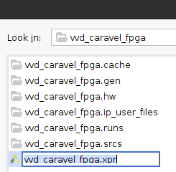
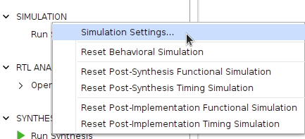
Run Simulation in Vivado GUI
Open Vivado project: vvd_caravel_fpga
Right click on the “SIMULATION” and select Simulation Setting

Slide 5
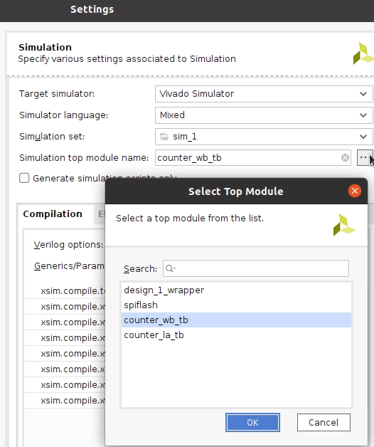
Run Simulation in Vivado GUI
Select which test bench you want to run in the “Simulation top module name”

Slide 6
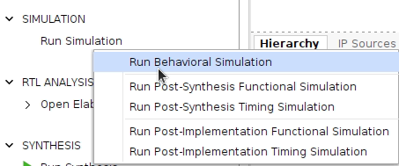
Run Simulation in Vivado GUI
Select which test bench you want to run in the “Simulation top module name”
Click “Run Behavior Simulation”

Slide 7
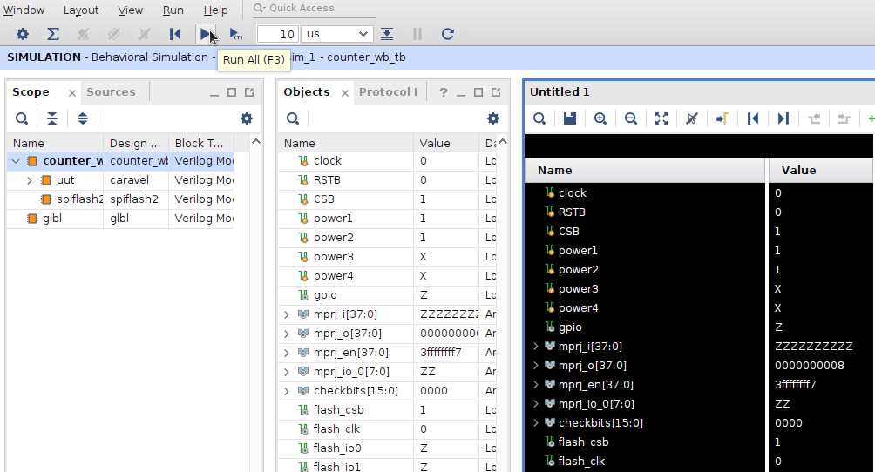
Run Simulation in Vivado GUI
Click the “Run All” button to run the testbench and monitor the waveform

Slide 8
JuypterNotebook: caravel_fpga.ipynb
Select one firmware binary to load into BRAM as SPIROM data
fiROM = open("counter_wb.hex", "r+") or
fiROM = open("counter_la.hex", "r+") or
fiROM = open(“gcd_la.hex", "r+") or
Release reset to make Caravel-soc start execute firmware code
ipOUTPIN.write(0x10, 1)
Note: If you want to load different firmware binary without restart FPGA, you need to assert & release reset signal for the caravel-soc to make CPU execute new firmware.
Load counter_wb.hex
Release reset by ipOUTPIN.write(0x10, 1), check mprj_i/o/en
Load counter_la.hex
Assert reset by ipOUTPIN.write(0x10, 0)
Release reset by ipOUTPIN.write(0x10, 1), check mprj_i/o/en

